Slide 1
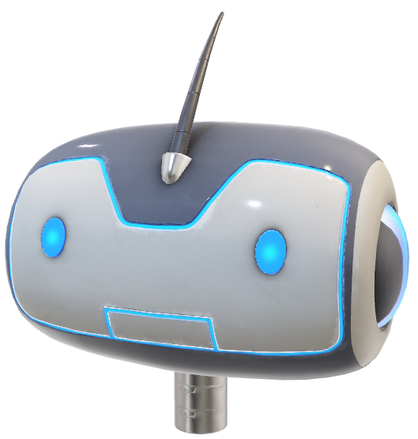
PROJECT VOICE ASSISTANT
1
Hi, I am JARVIS Your Personal Assistant.
Hello
How can I help you ?
Open/Play……..
GROUP 4
JASPREET SINGH | SONU SONI | VISHAL AGGARWAL | DHRUV KUMAR
20BCS1054 | 20BCS1112 | 20BCS1119 | 20BCS1140

Slide 2
WHAT IS ARTIFICIAL INTELLIGENCE (AI) ?
2
Artificial intelligence (AI), is intelligence demonstrated by machines, unlike the natural intelligence displayed by humans and animals. Leading AI textbooks define the field as the study of "intelligent agents": any device that perceives its environment and takes actions that maximize its chance of successfully achieving its goals.
The term "artificial intelligence" is often used to describe machines (or computers) that mimic "cognitive" functions that humans associate with the human mind, such as "learning" and "problem solving".

Slide 3
WHAT IS MACHINE LEARNING (ML) ?
3
Machine learning (ML) is the study of computer algorithms that improve automatically through experience. It is seen as a subset of artificial intelligence. Machine learning algorithms build a model based on sample data, known as "training data", in order to make predictions or decisions without being explicitly programmed to do so.
Machine learning algorithms are used in a wide variety of applications, such as email filtering and computer vision, where it is difficult or unfeasible to develop conventional algorithms to perform the needed tasks.

Slide 4
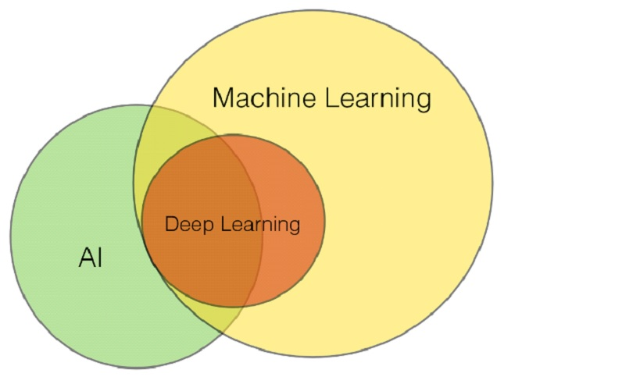
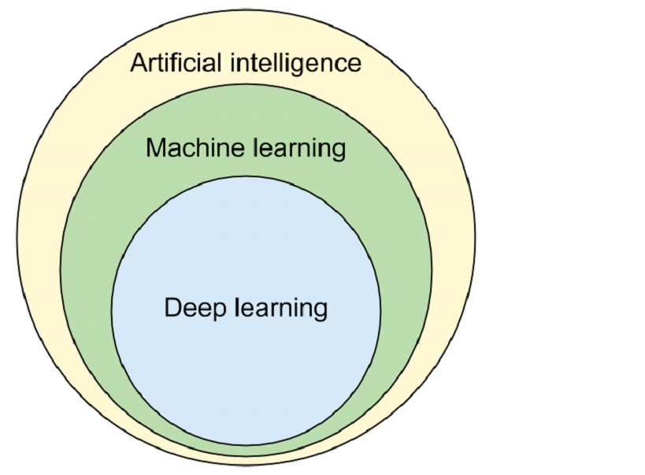
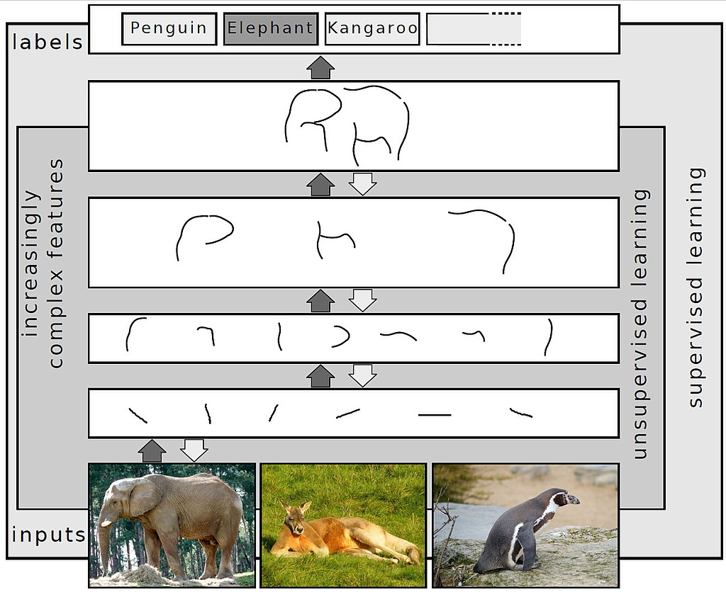
WHAT IS DEEP LEARNING ?
4
Deep learning (also known as deep structured learning) is part of a broader family of machine learning methods based on artificial neural networks with representation learning. Learning can be supervised, semi-supervised or unsupervised.

Slide 5
WHAT ARE AI ASSISTANTS ?
5
AI assistant or digital assistant, is an application program that understands natural language voice commands and completes tasks for the user.
Such tasks, historically performed by a personal assistant or secretary, include taking dictation, reading text or email messages aloud, looking up phone numbers, scheduling, placing phone calls and reminding the end user about appointments. Popular virtual assistants currently include Amazon Alexa, Apple's Siri, Google Assistant and Microsoft's Cortana

Slide 6
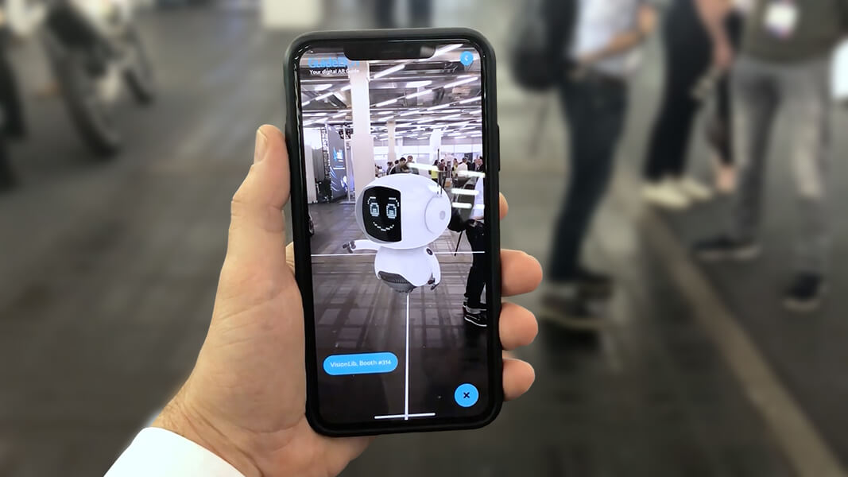
WHAT IS AUGMENTED REALITY ?
6
Augmented reality (AR) is an interactive experience of a real-world environment where the objects that reside in the real world are enhanced by computer-generated perceptual information, sometimes across multiple sensory modalities, including visual, auditory, haptic, somatosensory and olfactory.
AR can be defined as a system that fulfills three basic features: a combination of real and virtual worlds, real-time interaction, and accurate 3D registration of virtual and real objects.

Slide 7
SECTION - 1 IMPORTING LIBRARIES AND MODULES
7
import webbrowser
import speech_recognition as sr
import pyttsx3
from datetime import datetime

Slide 8
SECTION – 2 INITIALIZING THE RECOGNIZER & FUNCTION TO CONVERT TEXT TO SPEECH
8
r = sr.Recognizer()
def SpeakText(command):
# Initialize the engine
engine = pyttsx3.init('dummy') engine.say(command) engine.runAndWait()

Slide 9
SECTION – 3 SETTING LOOP INFINITELY FOR USER TO SPEAK & AND TAKING COMMANDS FROM THE USER
9
while(text_length<80):
try:
engine = pyttsx3.init()
engine.say("How can i help you")
engine.runAndWait()
# use the microphone as source for input.
with sr.Microphone() as source2:
# wait for a second to let the recognizer
# adjust the energy threshold based on
# the surrounding noise level
r.adjust_for_ambient_noise(source2, duration=0.2)
#listens for the user's input
audio2 = r.listen(source2)
# Using google to recognize audio
MyText = r.recognize_google(audio2)
MyText = MyText.lower()

Slide 10
THANKING YOU
10

